Slide 1

Cucumber with Selenium-Part 1

Slide 2
Introduction
Cucumber is a testing approach which supports Behavior Driven Development (BDD). It explains the behavior of the application in a simple English text using Gherkin language.
Cucumber is a testing framework that helps to bridge the gap between software developers and business managers.
Cucumber allows software development teams describe how software should behave in plain text. The text is written in a business-readable domain-specific language and serves as documentation, automated tests and development-aid – all rolled into one format.

Slide 3
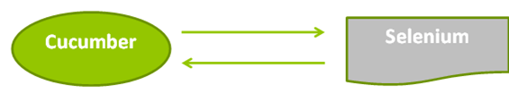
Importance of using Cucumber with selenium
Cucumber makes it easy to read and to understand the application flow.
Cucumber tool is based on the Behavior Driven Development framework that acts as the bridge between the following people:-
Software Engineer and Business Analyst.
Manual Tester and Automation Tester.
Manual Tester and Developers.
Cucumber also benefits the client to understand the application code as it uses Gherkin language which is in Plain Text.The syntax's of Gherkin is in simple text which is readable and understandable.

Slide 4
Feature File in Cucumber
A Feature File is an entry point to the Cucumber tests.
Feature File is a file where describe tests in Descriptive language (Like English).
It is an essential part of Cucumber, as it serves as an automation test script as well as live documents.
The following keywords defined by Gherkin in Feature File are:-
Feature: A feature would describe the current testscript which has to be executed.
Scenario: Scenario would describe the steps and expected outcome for a particular test case.
Background: Background describes the steps that would be executed before each scenario
Scenario Outline: Using Scenario Outline, execute the same scenarios for multiple sets of data. The data is provided in a tabular structure.
Given: ‘Given’ specifies the context of the text to be executed. Given step can also be parameterized using data tables.
When: ‘When’ specifies the test action to be performed.
Then: ‘Then’ specifies the expected outcome of the test.

Slide 5
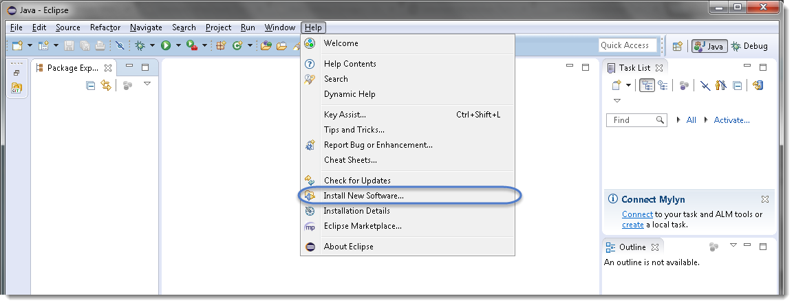
Install Cucumber Plugin
Step1) Launch the Eclipse IDE and from Help menu, click “Install New Software”.
Step 2) Now dialog window will appear, click “Add” button.

Slide 6
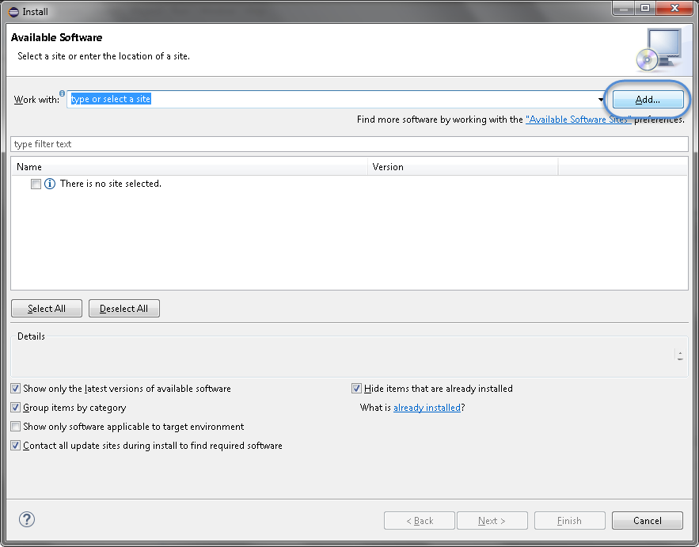
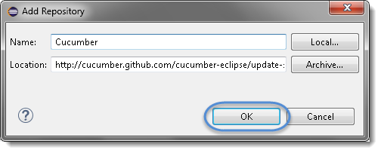
Step 3) Type name as “Cucumber” and type “http://cucumber.github.com/
cucumber-eclipse/update-site”
as location. Click OK.

Slide 7
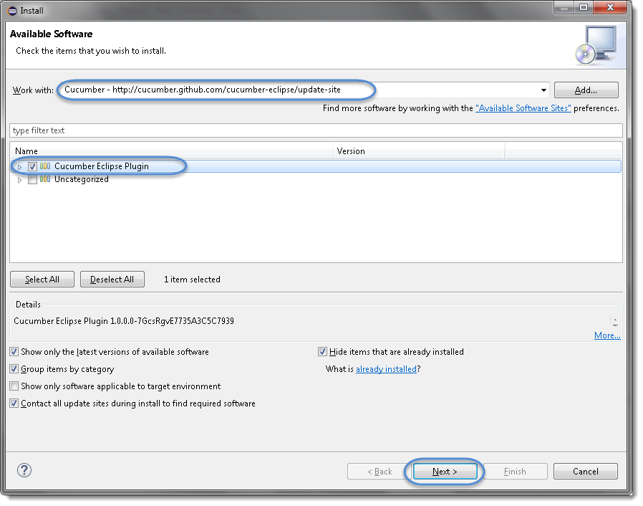
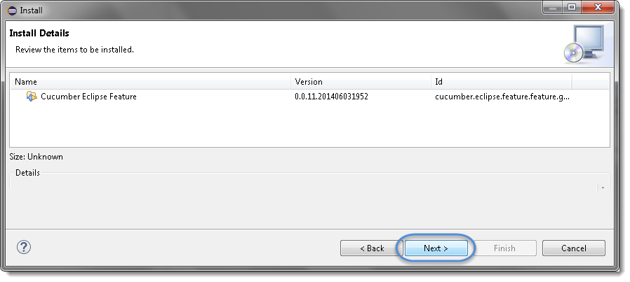
Step 4) Now back to the previous window but this time see Cucumber Eclipse Plugin option in the available software list. Just Check the box and press “Next” button.
Step 5) Click on Next.

Slide 8
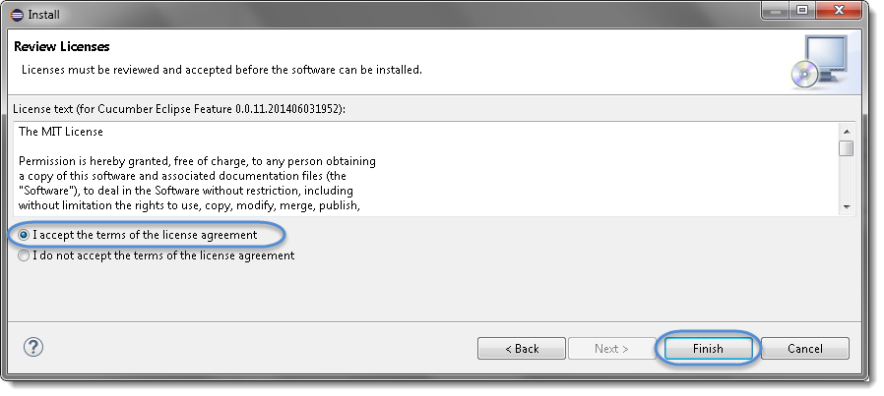
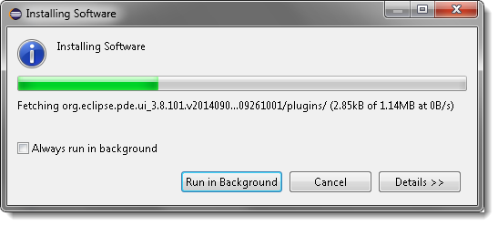
Step 6) Click “I accept the terms of the license agreement” then click Finish.
Step 7) Let it install, it will take few seconds to complete.

Slide 9
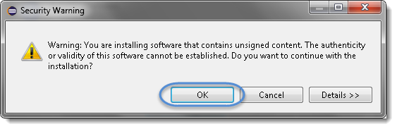
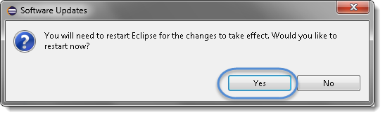
Step 8) You may or may not encounter a Security warning, if in case you do
just click OK.
Step 9) You are all done now, just Click Yes.

Slide 10
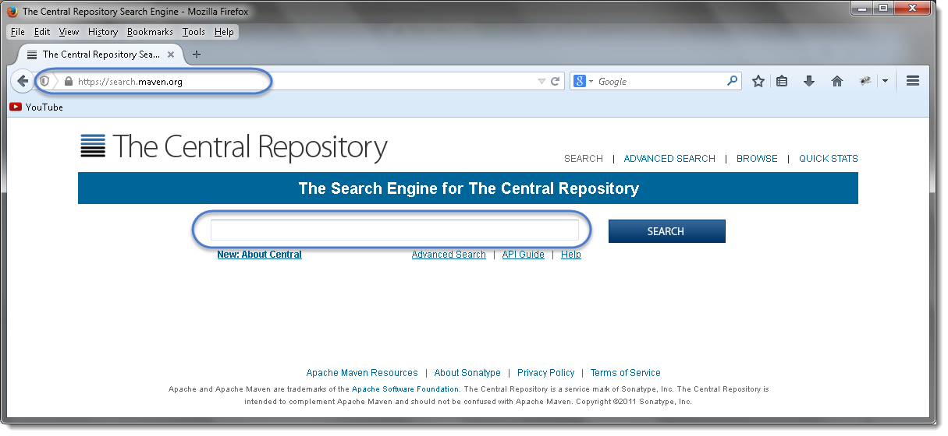
Download Cucumber JVM for Eclipse
Step1) Go to https://search.maven.org.
Step 2) Search for cucumber-core in the Central Maven Repository. It will return the Cucumber Core jars. Click on the jar.

Slide 11
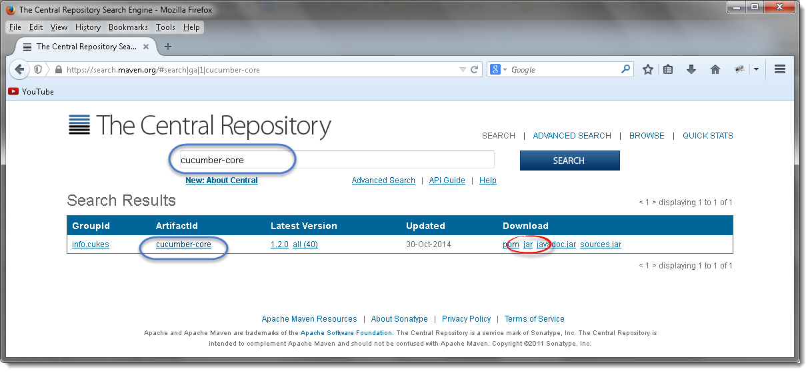
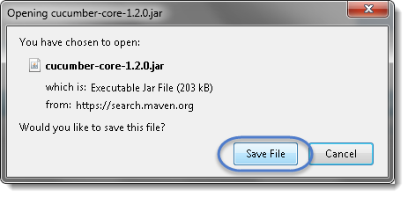
Step 3) It will display a pop up and ask to
save the cucumber core jar file.

Slide 12
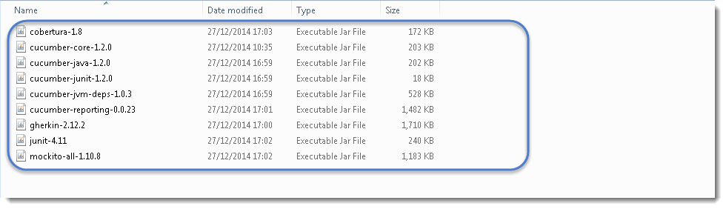
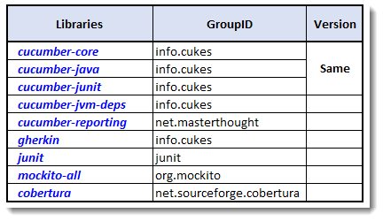
Step 4) one by one search for every other jar file mentioned above and
downloads these to your drive according their GroupID.
Step 5) Download Selenium-server-standalone to “http://www.seleniumhq.org/download/ “ link

Slide 13
Covered Till Now
Cucumber is a testing approach which supports Behavior Driven Development (BDD). It explains the behavior of the application in a simple English text using Gherkin language.
Importance of cucumber with selenium
Feature file in cucumber
Installation of cucumber plugin for eclipse
Download cucumber JVM for eclipse

Slide 14
Thanks

